Slide 1
Food Distribution Program
Getting Started in WBSCM Part III: Major Changes
Texas Department of Agriculture
USDA Division

Slide 2
Acknowledgement Statement
You understand and acknowledge that:
The training you are about to take does not cover the entire scope of the program; and that
You are responsible for knowing and understanding all handbooks, manuals, alerts, notices, and guidance, as well as any other forms of communication that provide further guidance, clarification, or instruction on operating the program.

Slide 3
01
Introduction
Why transition to WBSCM?
02
Overview of Changes
Summary of FDP process changes with WBSCM transition
03
Contract Packet Replacement
Opt-in to USDA Foods
04
Survey Changes
TX-UNPS survey replacements
05
Farm to School Changes
Opting in, entitlement, where to request
06
Weekly Commodity Bulletin Replacement
Overview of Changes
Accessing reports/data
07
Third Party Access
FSMC/CO-OP access

Slide 4
01
Why WBSCM?
(TX-UNPS was fine! )

Slide 5
Why WBSCM?
The FDP Module in TX-UNPS does not have an upgrade.
Since 2010, TDA has used the Web Based Supply Chain Management System (WBSCM) to submit RA orders to USDA.
USDA owns and regularly upgrades WBSCM, making it the best solution to serve RAs in Texas now and in the future.
Notes:
Review information on screen with RAs

Slide 6
6
USDA Foods Process & Efficiency Change
Since 2010, TDA has used WBSCM to:
Create catalogs
Manage RA requisitions
Track entitlement
Transitioning from TX-UNPS to WBSCM gives RAs the same real-time access as TDA.
Previous Process
TDA manually adds Surveys into TX-UNPS
RAs enter requests into TX-UNPS Surveys
TDA approves requests in WBSCM
TDA manually adds data in TX-UNPS Weekly Commodity Bulletin
TDA re-creates WBSCM Catalog as a Survey
TDA manually adds TX-UNPS Survey data into WBSCM
TDA downloads TX- UNPS Survey data
TDA creates Catalog in WBSCM
RAs check Weekly Commodity Bulletin (delayed data)
New Process
RAs enter requests directly into WBSCM
TDA approves requests in WBSCM
No waiting
Less errors
No waiting
Less errors
No waiting
Less errors
TDA Creates Catalog in WBSCM
RAs run WBSCM Reports
(real-time data)
Notes:
Read slide
Transition will have the same real time access to catalogs, requisition managements, and entitlement tracking.
Previous process, TDA would recreate Web-SCM catalogs as a survey in TX-UNPS
Then TDA staff would manually add the surveys into TX-UNPS for RAs to enter their requests
When data updated, TDA would download the TX-UNPS survey data, manually add that data into WebSCM, before approving requests and submitting to USDA
The TDA would add that data back in to TX-UNPS through the weekly commodity bulleting which districts would check with that information being delayed due to the manual updating of the weekly commodity bulletin
New process – districts will enter info in WeBSCM with no waiting and real time access to data thru reports
Review previous process information on slide and the new process information that includes efficiency gains with the transition to RA use of WBSCM

Slide 7
7
Requesting USDA Foods Systems Change
Previous
TX-UNPS Surveys
FFAVORS used to request DOD Fresh
TX-UNPS Surveys used to request:
Brown Box
Processing
Farm to School
FFAVORS
Previously
Farm to School (Opt in to Participate)
Processing Diversion
DoD Fresh (Opt in to Participate)
Brown Box
New
CHANGE!
FFAVORS used to request:
DoD Fresh
Local Grown (formerly Farm to School)
WBSCM used to request:
Direct Delivery (formerly Brown Box)
Processing
FFAVORS
WBSCM Catalog
NEW!
Processing Diversion
CHANGE!
DoD Fresh
Local Grown (Formerly Farm to School)
Direct Delivery (Formerly Brown Box)
Opt-in to DoD Fresh to Participate
Notes:
Review previous process and new process information on the slide

Slide 8
02
Overview of Changes

Slide 9
Summary of Major Changes
Action/Process |  | Old |  | NEW!
Participating in USDA Foods |  | TX-UNPS Contract Packet |  | TX-UNPS SNP Application Packet Question A25
Requesting Brown Box and Processing |  | TX-UNPS Surveys |  | WBSCM Catalogs
Participating in Farm to School |  | TX-UNPS Surveys |  | DoD JotForm
Farm to School Entitlement |  | Separately Allocated |  | Co-mingled with DoD Fresh Entitlement
Requesting Farm to School |  | TX-UNPS Surveys |  | Local Grown in FFAVORS Catalogs
Weekly Commodity Bulletin |  | TX-UNPS |  | WBSCM Reports, Warehouse Tracking Systems
FSMCs and Co-Ops |  | TX-UNPS Access |  | No WSBCM Access
Notes:
Review summary of changes for the processes listed on the slide

Slide 10
03
Contract Packet Replacement

Slide 11
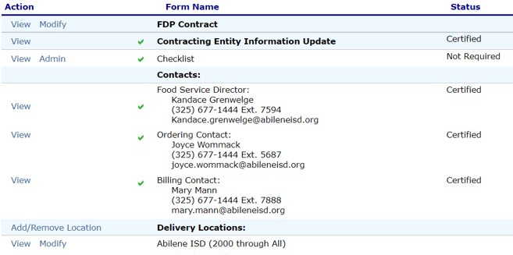
11
Contract Packet Replacement
Contract Packets are eliminated and replaced by SNP Application Packet

Slide 12
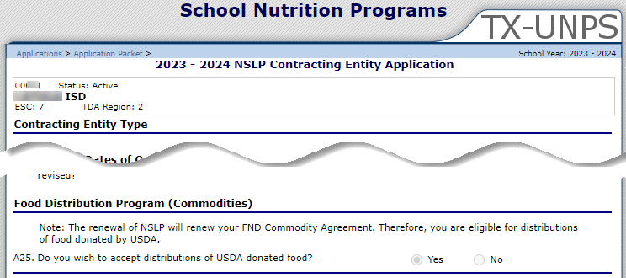
12
Contract Packet Replacement
CHANGE!
Complete SNP Application Packet in TXUNPS
Mark “Yes” to question A25 to participate in USDA Foods
Mark “Yes” to question A25
Notes:
Review Contract Replacement Information slide

Slide 13
04
Survey Changes

Slide 14
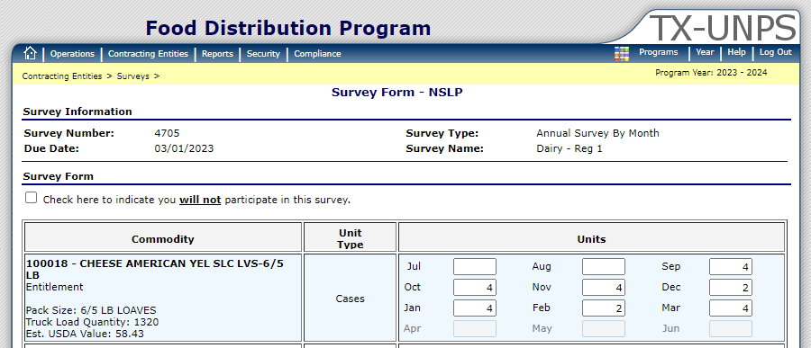
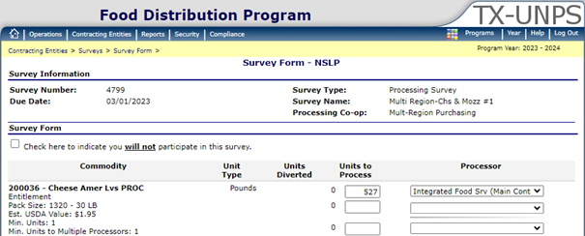
14
TX-UNPS Surveys Eliminated
TX-UNPS Surveys are eliminated
Direct Delivery and Processing now requested in WBSCM
Notes:
Review Survey replacement information on the slide

Slide 15
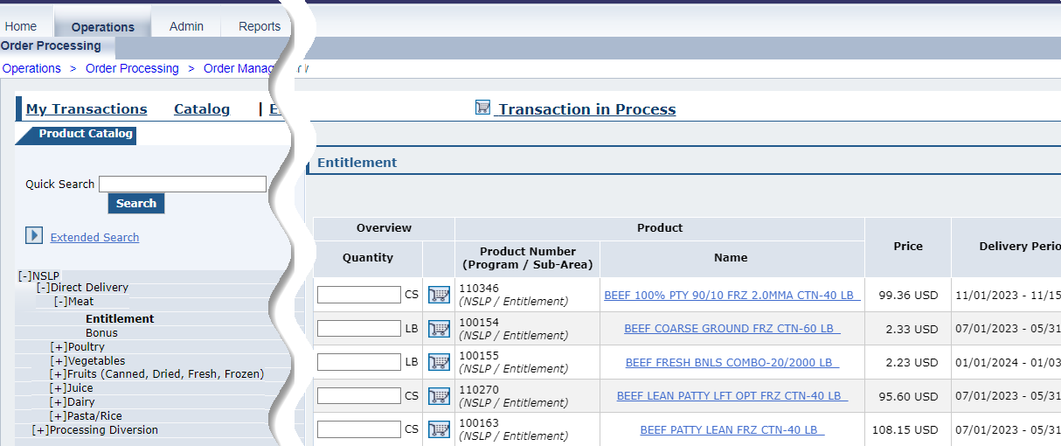
15
WBSCM Catalogs
Direct Delivery and Processing Requests
Request Direct Delivery and Processing through WBSCM
Farm to School items will be designated as “Local Grown”
Request Local Grown through FFAVORS
Minimum value per order, per delivery site = $150

Slide 16
05
Farm to School Changes

Slide 17
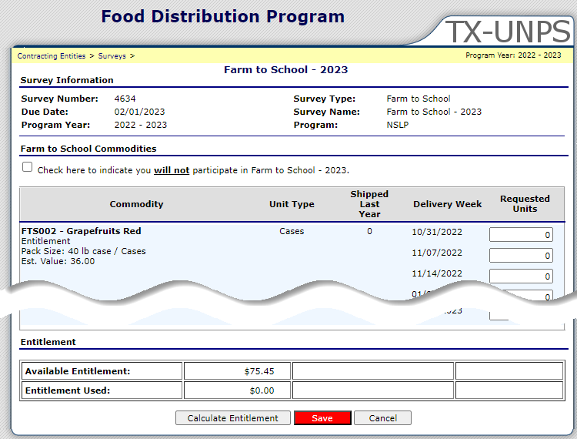
17
Farm to School Changes
Farm to School Surveys in TX-UNPS are eliminated
Farm to School is now Local Grown in FFAVORS
Notes:
Review Farm to School changes on the slide

Slide 18
18
Farm to School Changes: Opting In
RAs must opt-in to DoD Fresh to access Local Grown (formerly Farm to School)
Select “Yes” in DoD JotForm
sent by TDA to opt-in to Local Grown (formerly Farm to School)
Notes:
Review Farm to School changes on the slide

Slide 19
19
Farm to School Changes: Farm to School Merged with DoD Fresh
Farm to School items will be designated as “Local Grown”
Request Local Grown through FFAVORS
Minimum value per order, per delivery site = $150
Select “Local Grown” products in FFAVORS catalog
Notes:
Review Farm to School changes on the slide

Slide 20
06
Weekly Commodity Bulletin Replacement

Slide 21
21
Weekly Commodity Bulletin Replacement: Account Status
TX-UNPS Account Status
Entitlement balance now in WBSCM Entitlement Reports
OLD
NEW
WBSCM Reports Module: Entitlement Management
Notes:
Review Commodity Bulletin replacement information on the slide

Slide 22
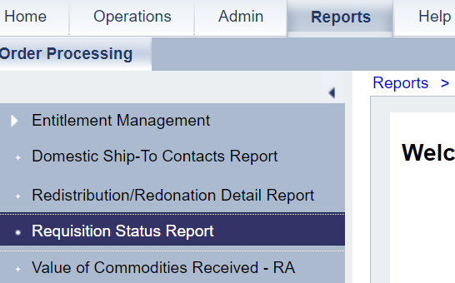
22
Weekly Commodity Bulletin Replacement: Shipments Expected to Warehouse
OLD
WBSCM Reports Module: Requisition Status Report
TX-UNPS Shipments Expected into Warehouse
NEW
Shipment Status now in WBSCM Requisition Status Report
Notes:
Review Commodity Bulletin replacement information on the slide

Slide 23
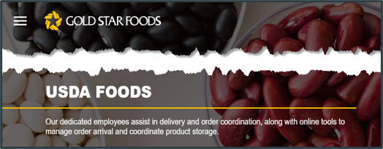
23
Weekly Commodity Bulletin Replacement: Summary of Commodities in Warehouse
TX-UNPS Summary of Commodities in Warehouse
Warehouse Tracking Systems
OLD
NEW
Summary of Commodities in Warehouse now found in Warehouse Tracking Systems
Notes:
Review Commodity Bulletin replacement information on the slide

Slide 24
24
Weekly Commodity Bulletin Replacement: Summary of Commodities by Storage Type
TX-UNPS Summary of Commodities by Storage Type
Warehouse Tracking Systems
OLD
NEW
Summary of Commodities by Storage Type now in Warehouse Tracking Systems
Notes:
Review Commodity Bulletin replacement information on the slide

Slide 25
07
FSMC / CO-OP
WBSCM ACCESS

Slide 26
26
WBSCM Access: FSMCs and Co-ops
Can FSMCs/Co-Ops be given access to WBSCM?
No, TDA is not providing access as WBSCM is considered a type of “bank account”.
Anyone that does not directly work for a Recipient Agency responsible for a WBSCM account is considered a high security and audit risk.
Notes:
Review FSMC and Co-op Access changes on the slide

Slide 27
27
WBSCM Access: FSMCs and Co-ops
Can FSMCs or Co-Op Coordinators have View Only access?​
FSMCs and Co-Ops cannot have access to WBSCM.​
Can districts give FSMC/Co-Ops access to WBSCM presentations?
Can FSMCs attend or receive WBSCM training?
TDA cannot train private companies that work with CNPs as it is not an allowable cost for our federal funding at the state level.
TDA will train Recipient Agencies through the ESC Child Nutrition Specialists. FSMC/Co-Op employees will not be invited to participate in this training.
Notes:
Review FSMC and Co-op Access changes on the slide

Slide 28
Review of Major Changes
Action/Process |  | Old |  | NEW!
Participating in USDA Foods |  | TX-UNPS Contract Packet |  | TX-UNPS SNP Application Packet Question A25
Requesting Brown Box and Processing |  | TX-UNPS Surveys |  | WBSCM Catalogs
Participating in Farm to School |  | TX-UNPS Surveys |  | DoD JotForm
Farm to School Entitlement |  | Separately Allocated |  | Co-mingled with DoD Fresh Entitlement
Requesting Farm to School |  | TX-UNPS Surveys |  | Local Grown in FFAVORS Catalogs
Weekly Commodity Bulletin |  | TX-UNPS |  | WBSCM Reports, Warehouse Tracking Systems
FSMCs and Co-Ops |  | TX-UNPS Access |  | No WSBCM Access
Notes:
Review summary of changes for the processes listed on the slide

Slide 29
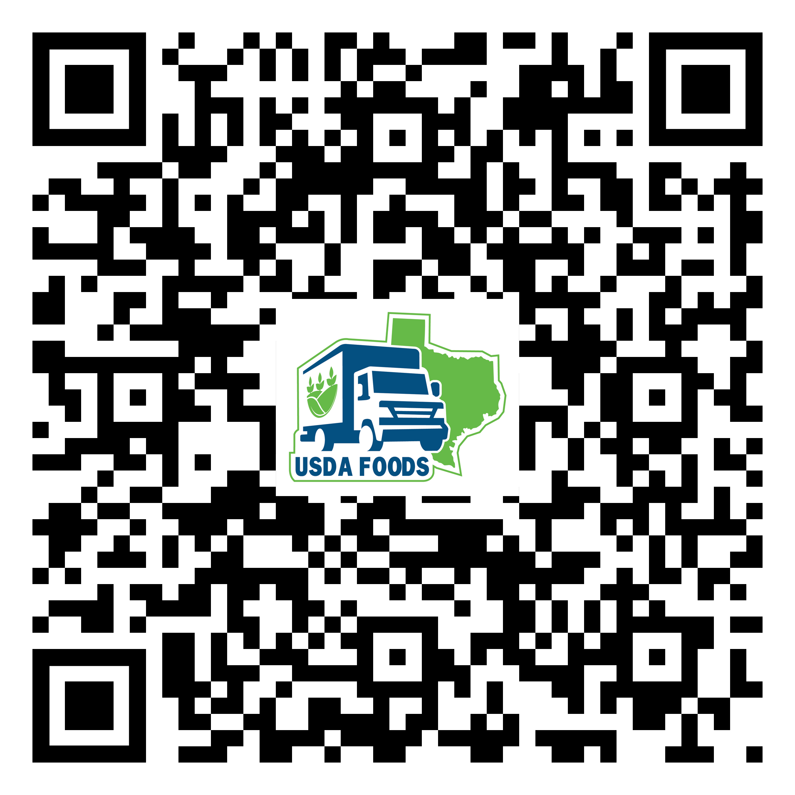
WBSCM Transition Page QR Code:
Scan QR Code to visit the Food Distribution Program WBSCM Transition website
Notes:
TRAINER NOTE:
May hide this slide if desired and/or training multiple modules at once.

Slide 30
Questions?

Slide 32
Contact Us
https://squaremeals.org/Programs/FDPWBSCMTransitionProject.aspx
Contact Your Education Service Center

